Slide 1
Annual Review for
Galasa

Slide 2
Instructions (REMOVE SLIDE IN FINAL)
Please use this deck in preparation for your project’s annual review. Depending upon your project’s stage, the review will have different points.
Incubation project:
Review of progress towards Early Adoption Stage
Early Adoption project:
Review of progress towards Graduated Stage
Graduated project:
Review of project maintaining positive growth and adoption
Please use the appropriate section in this deck for building the review deck. Add additional slides for addressing specific review points.
Each project has 20 minutes for both their presentation and Q/A, so plan your presentation accordingly.

Slide 3
<your project name>
Brief Description:
Galasa is an application integration test framework designed to make hybrid cloud application and platform testing
TSC Chairperson:
Name and email
TSC Members and Affiliations:
list...
Contributed by:
Contribution organization
Key Links:
Github: www.github.com/galasa-dev
Website: www.galasa.dev
Artwork: URL
Mailing lists:
mailing list name and link
mailing list name and link
mailing list name and link
OpenSSF Best Practice Badge URL: URL

Slide 4
Incubation Project review criteria
To be considered for the Incubation Stage, the project must meet the following requirements:
Have completed and approved the Technical Charter and agree to transfer any relevant trademarks to The Linux Foundation or its affiliate, LF Projects, LLC, and to assist in filing for any relevant unregistered ones.
Have defined its technical governance, including:
A LICENSE file in every code repository, with the license chosen being an OSI-approved license.
A README file welcoming new community members to the project and explaining why the project is useful and how to get started.
A CONTRIBUTING file explaining to other developers and your community of users how to contribute to the project. The file should explain the types of contributions needed and how the process works.
A CODEOWNERS or COMMITTERS file to define individuals or teams that are responsible for code in a repository; document current project owners and current and emeritus committers.
A CODE_OF_CONDUCT file that sets the ground rules for participants’ behavior associated and helps to facilitate a friendly, welcoming environment. By default, projects should leverage the Linux Foundation Code of Conduct unless an alternate Code of Conduct is approved prior.
A RELEASE file that provides documentation on the release methodology, cadence, criteria, etc.
A GOVERNANCE file that documents the project’s technical governance.
A SUPPORT file to let users and developers know about ways to get help with your project.

Slide 5
Incubation Project review criteria ( continued )
Have achieved and maintained an OpenSSF Best Practices Badge at the 'passing' level.
Have had a successful license scan with any critical issues remedied.
An overview of the project’s architecture and features defined.
A project roadmap is defined, which should address the following questions.
What use cases are possible now?
What does the next year look like regarding additional features and use cases covered?
Community and contributor growth assessment
The current number of contributors and committers and the number of different organizations contributing to the project.
Generally, the TAC will look for 2 to 3 committers, but one committer may be acceptable for a high-quality project.
Demonstrate a sustained flow of commits / merged contributions
A credible plan for developing a thriving user community, particularly expanding the number of committers and contributors?
Outline of the plan for the project to complete the requirements for Active Stage

Slide 6
Active Project review criteria
To be accepted at the Active Stage, a project must have completed the Incubation Stage requirements plus the following requirements:
Have committers from at least two organizations.
Have achieved and maintained an OpenSSF Best Practices Badge at the 'Gold' level.
Demonstrable roadmap progress.
The sustained flow of commits / merged contributions.
A healthy number of public adopters identified within the project ( using an ADOPTERS.md page or having showcased on the project’s website ).
Elect or appoint a project lead to represent the project on the TAC.

Slide 7
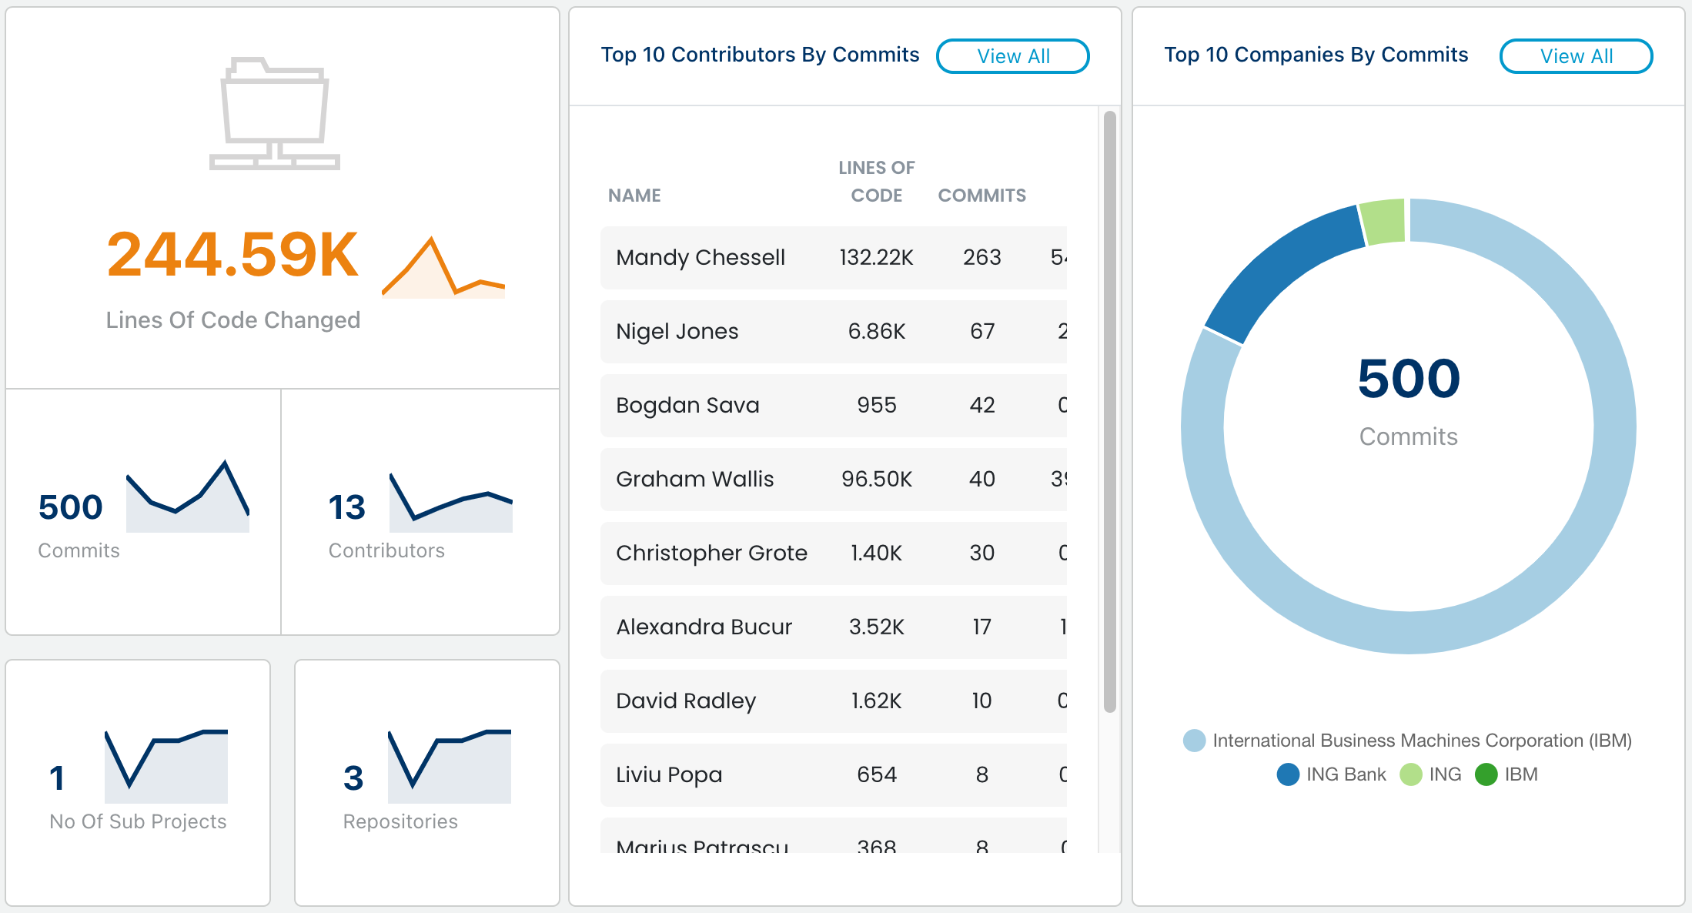
Contributions
UPDATE FROM LFX INSIGHTS

Slide 8
Organizations contributing and/or using in production
Provide list of organizations, with logos if available

Slide 9
Key Achievements in the past year

Slide 10
Areas the project could use help on

Slide 11
Feedback on working with the Open Mainframe Project

Slide 12
TAC Open Discussion

